Slide 1

Packages
P Y T H O N
Zakaria Ahmed
Omar Mohsen
Bassant Adel

Slide 2
Motivation
Functions and methods are powerful
All code in Python distribution?
Huge code base: messy
Lots of code you won’t use Maintenance problem

Slide 3
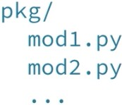
Packages
Directory of Python Scripts
Each script = module
Specify functions, methods, types
Thousands of packages available
NumPy
Matplotlib scikit-learn

Slide 4
Install package
https://pip.pypa.io/en/stable/installation/
Download get-pip.py
Terminal:
python3 get-pip.py
pip3 install numpy

Slide 5
Import package
numpy array([1, 2, 3])
numpy np np.array([1, 2, 3])
NameError: name 'array' is not defined
array([1, 2, 3])
numpy.array([1, 2, 3])
numpy array([1, 2, 3])
array
array([1, 2, 3])
array([1, 2, 3])

Slide 6
from numpy import array
my_script.py
numpy array
fam = ["liz", 1.73, "emma", 1.68,
"mom", 1.71, "dad", 1.89]
...
fam_ext = fam + ["me", 1.79]
...
print(str(len(fam_ext)) + " elements in fam_ext")
...
np_fam = array(fam_ext)
Using NumPy, but not very clear

Slide 7
import numpy
numpy np
fam = ["liz", 1.73, "emma", 1.68,
"mom", 1.71, "dad", 1.89]
...
fam_ext = fam + ["me", 1.79]
...
print(str(len(fam_ext)) + " elements in fam_ext")
...
np_fam = np.array(fam_ext) # Clearly using NumPy

Slide 8
NumPy
P Y T H O N
Zakaria Ahmed
Omar Mohsen
Bassant Adel

Slide 9
Lists Recap
Powerful
Collection of values Hold different types Change, add, remove Need for Data Science
Mathematical operations over collections
Speed

Slide 10
Illustration
height = [1.73, 1.68, 1.71, 1.89, 1.79]
height
[1.73, 1.68, 1.71, 1.89, 1.79]
weight = [65.4, 59.2, 63.6, 88.4, 68.7]
weight
[65.4, 59.2, 63.6, 88.4, 68.7]
weight / height ** 2
TypeError: unsupported operand type(s) for ** or pow(): 'list' and 'int'

Slide 11
Solution: NumPy
Numeric Python
Alternative to Python List: NumPy Array Calculations over entire arrays
Easy and Fast
Installation
In the terminal: pip3 install numpy

Slide 12
NumPy
numpy np
np_height = np.array(height) np_height
array([1.73, 1.68, 1.71, 1.89, 1.79])
np_weight = np.array(weight) np_weight
array([65.4, 59.2, 63.6, 88.4, 68.7])
bmi = np_weight / np_height ** 2 bmi
array([21.85171573, 20.97505669, 21.75028214, 24.7473475 , 21.44127836])

Slide 13
Comparison
height | = | [1.73, | 1.68, 1.71, 1.89, 1.79]
weight | = | [65.4, | 59.2, 63.6, 88.4, 68.7]
weight | / | height | ** 2
TypeError: unsupported operand type(s) for ** or pow(): 'list' and 'int'
np_height | = | np.array(height)
np_weight | = | np.array(weight)
np_weight | / | np_height ** 2
array([21.85171573, 20.97505669, 21.75028214, 24.7473475 , 21.44127836])

Slide 14
NumPy: remarks
np.array([1.0, "is", True])
array(['1.0', 'is', 'True'], dtype='<U32')
NumPy arrays: contain only one type

Slide 15
NumPy: remarks
python_list = [1, 2, 3]
numpy_array = np.array([1, 2, 3])
python_list + python_list
[1, 2, 3, 1, 2, 3]
numpy_array + numpy_array
array([2, 4, 6])
Different types: different behavior!

Slide 16
NumPy Subsetting
bmi
array([21.85171573, 20.97505669, 21.75028214, 24.7473475 , 21.44127836])
bmi[1]
20.975
bmi > 23
array([False, False, False,
True, False])
bmi[bmi > 23]
array([24.7473475])

Slide 17
2D NumPy Arrays
P Y T H O N
Zakaria Ahmed
Omar Mohsen
Bassant Adel

Slide 18
Type of NumPy Arrays
numpy | np
np_height = | np.array([1.73, | 1.68, | 1.71, | 1.89, | 1.79])
np_weight = | np.array([65.4, | 59.2, | 63.6, | 88.4, | 68.7])
type(np_height)
numpy.ndarray
type(np_weight)
numpy.ndarray

Slide 19
2D NumPy Arrays
np_2d = np.array([[1.73, 1.68, 1.71, 1.89, 1.79],
[65.4, 59.2, 63.6, 88.4, 68.7]])
np_2d
array([[ 1.73, 1.68, 1.71, 1.89, 1.79],
[65.4 , 59.2 , 63.6 , 88.4 , 68.7 ]])
np_2d.shape
(2, 5) # 2 rows, 5 columns
np.array([[1.73, 1.68, 1.71, 1.89, 1.79],
[65.4, 59.2, 63.6, 88.4, "68.7"]])
array([['1.73', '1.68', '1.71', '1.89', '1.79'],
['65.4', '59.2', '63.6', '88.4', '68.7']], dtype='<U32')

Slide 20
Subsetting
 | 0 | 1 | 2 | 3 | 4
array([[ | 1.73, | 1.68, | 1.71, | 1.89, | 1.79], | 0
[ | 65.4, | 59.2, | 63.6, | 88.4, | 68.7]]) | 1
np_2d[0]
array([1.73, 1.68, 1.71, 1.89, 1.79])

Slide 21
Subsetting
0 |  | 1 | 2 | 3 | 4
array([[ | 1.73, | 1.68, | 1.71, | 1.89, | 1.79], | 0
[ | 65.4, | 59.2, | 63.6, | 88.4, | 68.7]]) | 1
np_2d[0][2]
1.71
np_2d[0, 2]
1.71

Slide 22
Subsetting
0 | 1 | 2 | 3 | 4
array([[ 1.73, | 1.68, | 1.71, | 1.89, | 1.79], | 0
[ 65.4, | 59.2, | 63.6, | 88.4, | 68.7]]) | 1
np_2d[:, 1:3]
array([[ 1.68, | 1.71],
[59.2 , | 63.6 ]])
np_2d[1, :]
array([65.4, 59.2, 63.6, 88.4, 68.7])

Slide 23
NumPy: Basic Statistics
P Y T H O N
Zakaria Ahmed
Omar Mohsen
Bassant Adel

Slide 24
Data analysis
Get to know your data
Little data -> simply look at it Big data -> ?

Slide 25
City-wide survey
numpy np
np_city = ... # Implementation left out np_city
array([[1.64, | 71.78],
[1.37, | 63.35],
[1.6 , | 55.09],
...,
[2.04, | 74.85],
[2.04, | 68.72],
[2.01, | 73.57]])

Slide 26
NumPy
np.mean(np_city[:, 0])
1.7472
np.median(np_city[:, 0])
1.75

Slide 27
NumPy
np.corrcoef(np_city[:, 0], np_city[:, 1])
array([[ 1. , -0.01802],
[-0.01803, 1. ]])
np.std(np_city[:, 0])
0.1992
sum(), sort(), ...
Enforce single data type: speed!

Slide 28
Generate data
Arguments for np.random.normal()
distribution mean
distribution standard deviation number of samples
height = np.round(np.random.normal(1.75, 0.20, 5000), 2)
weight = np.round(np.random.normal(60.32, 15, 5000), 2) np_city = np.column_stack((height, weight))

Slide 29
Pandas
P Y T H O N
Zakaria Ahmed
Omar Mohsen
Bassant Adel

Slide 30
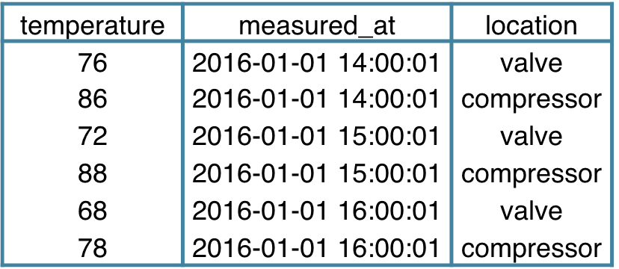
Tabular dataset examples

Slide 31
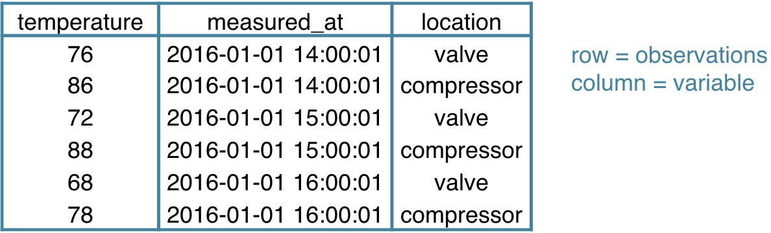
Tabular dataset examples

Slide 32
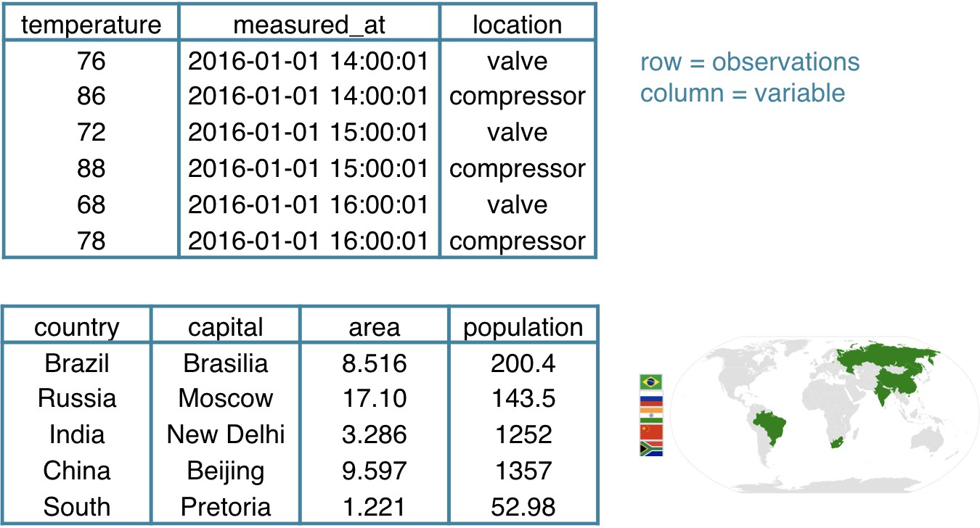
Tabular dataset examples

Slide 33
Datasets in Python
2D NumPy array? One data type

Slide 34
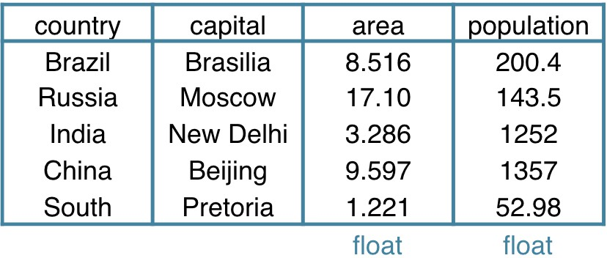
Datasets in Python

Slide 35
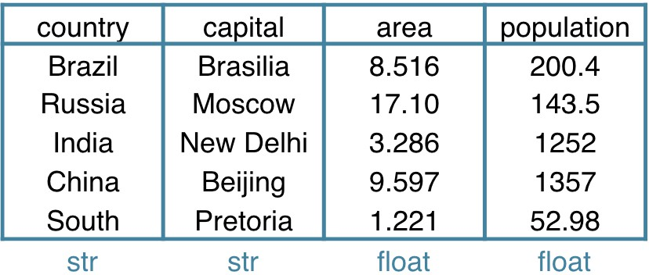
Datasets in Python
pandas!
High level data manipulation tool
Wes McKinney Built on NumPy DataFrame

Slide 36
DataFrame
brics
 | country | capital | area | population
BR | Brazil | Brasilia | 8.516 | 200.40
RU | Russia | Moscow | 17.100 | 143.50
IN | India | New Delhi | 3.286 | 1252.00
CH | China | Beijing | 9.597 | 1357.00
SA | South Africa | Pretoria | 1.221 | 52.98

Slide 37
DataFrame from Dictionary
dict = {
"country":["Brazil", "Russia", "India", "China", "South Africa"],
"capital":["Brasilia", "Moscow", "New Delhi", "Beijing", "Pretoria"], "area":[8.516, 17.10, 3.286, 9.597, 1.221]
"population":[200.4, 143.5, 1252, 1357, 52.98] }
keys (column labels)
values (data, column by column)
pandas pd
brics = pd.DataFrame(dict)

Slide 38
DataFrame from Dictionary (2)
brics
area | capital | country | population
0 8.516 | Brasilia | Brazil | 200.40
1 17.100 | Moscow | Russia | 143.50
2 3.286 | New Delhi | India | 1252.00
3 9.597 | Beijing | China | 1357.00
4 1.221 | Pretoria | South Africa | 52.98
brics.index = ["BR", "RU", "IN", "CH", "SA"]
brics
 | area | capital | country | population
BR | 8.516 | Brasilia | Brazil | 200.40
RU | 17.100 | Moscow | Russia | 143.50
IN | 3.286 | New Delhi | India | 1252.00
CH | 9.597 | Beijing | China | 1357.00
SA | 1.221 | Pretoria | South Africa | 52.98

Slide 39
DataFrame from CSV file
brics.csv
,country,capital,area,population BR,Brazil,Brasilia,8.516,200.4 RU,Russia,Moscow,17.10,143.5 IN,India,New Delhi,3.286,1252 CH,China,Beijing,9.597,1357
SA,South Africa,Pretoria,1.221,52.98
CSV = comma-separated values

Slide 40
DataFrame from CSV file
brics.csv
,country,capital,area,population BR,Brazil,Brasilia,8.516,200.4 RU,Russia,Moscow,17.10,143.5 IN,India,New Delhi,3.286,1252 CH,China,Beijing,9.597,1357 SA,South Africa,Pretoria,1.221,52.98
brics = pd.read_csv("path/to/brics.csv") brics
Unnamed: 0 | country | capital | area | population
0 BR | Brazil | Brasilia | 8.516 | 200.40
1 RU | Russia | Moscow | 17.100 | 143.50
2 IN | India | New Delhi | 3.286 | 1252.00
3 CH | China | Beijing | 9.597 | 1357.00
4 SA | South Africa | Pretoria | 1.221 | 52.98

Slide 41
DataFrame from CSV file
brics = pd.read_csv("path/to/brics.csv", index_col = 0) brics
 | country | population | area | capital
BR | Brazil | 200 | 8515767 | Brasilia
RU | Russia | 144 | 17098242 | Moscow
IN | India | 1252 | 3287590 | New Delhi
CH | China | 1357 | 9596961 | Beijing
SA | South Africa | 55 | 1221037 | Pretoria

